Slide 1
Computer Networks
1.<number>

Slide 2
1-1 DATA COMMUNICATIONS
The term telecommunication means communication at a distance. The word data refers to information presented in whatever form is agreed upon by the parties creating and using the data.
Data communications are the exchange of data between two devices via some form of transmission medium such as a wire cable or wireless.
Delivery → Correct destination
Accuracy → Accurate data
Timelines → Real-time transmission
Jitter → Uneven delay
1.<number>

Slide 3

Topics discussed in this section:
Components
Data Representation
Data Flow
Components
Figure 1.1 Five components of data communication
5
1
2
3
4
1.<number>

Slide 4

Data Representation
Text
Numbers
Images
Audio
Video
Data flow
Simplex
Half-duplex
Full-duplex
1.<number>

Slide 5
1-2 NETWORKS
A network is a set of devices (nodes) connected by communication links. A node can be a computer, printer, or any other device capable of sending and/or receiving data generated by other nodes on the network.
Topics discussed in this section:
Distributed Processing
Network Criteria (performance, reliability, and security)
Physical Structures ( type of connections and topologies)
Network Models
Categories of Networks ( LAN, MAN and WAN)
Interconnection of Networks: Internet
1.<number>

Slide 6
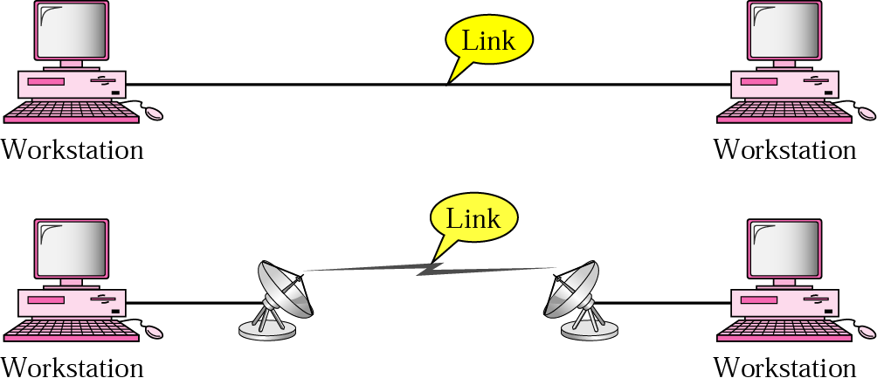
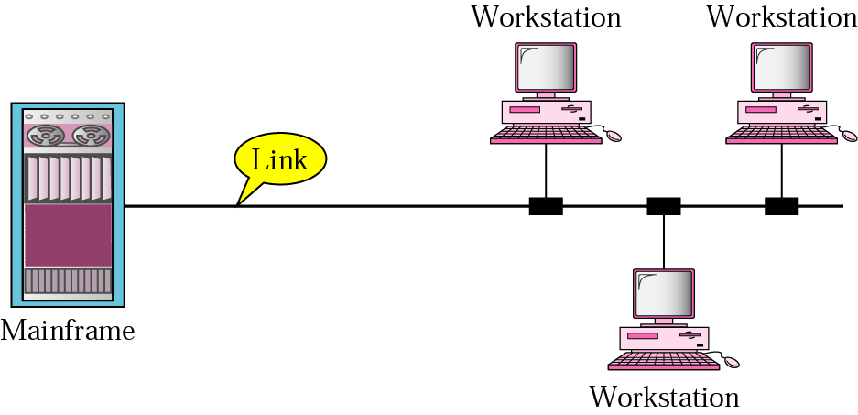
Types of connections
Point to point
  A dedicated link is provided between two devices
Multipoint
  More than two specific devices share a single link
1.<number>

Slide 7

Physical Topology
Tree
1.<number>

Slide 8
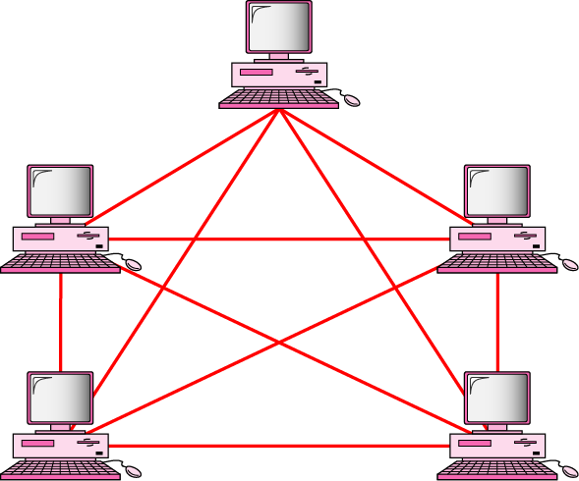
MESH Topology
Every device has a dedicated point-to-point link to every other devices
Dedicated
  Link carries traffic only between the two devices it connects
  A fully connected mesh network has n(n-1)/2 physical channels to link n devices
  Every device on the network must have n-1 input/output (I/O) ports
Advantage
  Less traffic, robust, secure, easy to maintain
Disadvantage
  Need more resource (cable and ports), expensive
n(n-1)/2 physical duplex links
1.<number>

Slide 9
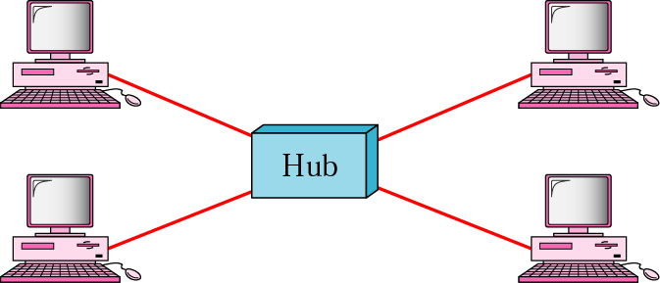
STAR Topology
Each device has a dedicated point-to-point link only to a central controller, usually called a hub.
No direct traffic and link between devices
Advantages
  Less expensive
  Easy to install and reconfigure
  Robustness
Disadvantage
  Single point of failure
1.<number>

Slide 10
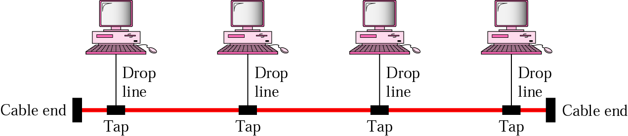
BUS Topology
A multipoint topology
All devices are linked through a backbone cable
Nodes are connected to the bus cable by drop lines and taps.
  Drop line
    A connection running between the device and the main cable
  Tap
    A connector that either splices into the main cable or punctures the sheathing of a cable to create a contact with the metallic core
Advantage:
  Ease of installation
  Disadvantages:
    Difficult reconnection and fault isolation
    Broken or fault of the bus cable stops all transmission
1.<number>

Slide 11

RING Topology
Each device is dedicated point-to-point connection only with the two devices on either side of it
A signal is passed along the ring in the direction, from device to device, until it reaches its destination
Each device in the ring incorporates a repeater
Advantages
  Relatively easy to install and reconfigure
  Fault isolation is simplified
Disadvantage
  Unidirectional traffic
1.<number>

Slide 12
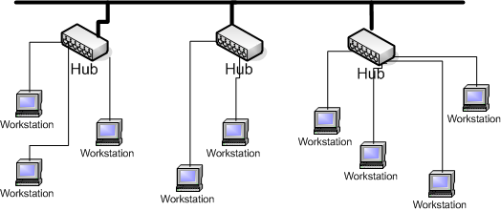
Tree Topology
Tree topologies integrate multiple topologies together
Example: Tree topology integrates multiple star topologies together onto a bus
Advantages:
  Point-to-point wiring for individual segments.
  Supported by several hardware and software venders.
Disadvantages:
  Overall length of each segment is limited by the type of cabling used.
  If the backbone line breaks, the entire segment goes down.
  More difficult to configure and wire than other topologies.
1.<number>

Slide 13

A hybrid topology: a star backbone with three bus networks
1.<number>

Slide 14

Categories of Networks
Local Area Network (LAN)
Wireless Local Area Network (WLAN)
Metropolitan Area Network (MAN)
Wide Area Network (WAN)
An isolated LAN connecting 12 computers to a hub in a closet
1.<number>

Slide 15

WANs: a switched WAN and a point-to-point WAN
1.<number>

Slide 16

Interconnection of Networks: internet
A heterogeneous network made of four WANs and two LANs
1.<number>

Slide 17
1-3 THE INTERNET
The Internet has changed many aspects of our daily lives. It has affected the way we do business as well as the way we spend our leisure time. The Internet is a communication system that has brought a wealth of information to our fingertips and organized it for our use.
Topics discussed in this section:
A Brief History → ARPANET
1967 ACM
1969 UCLA, UCSB, SRI, UoU
1972 TCP
The Internet Today (ISPs)
1.<number>

Slide 18

Hierarchical organization of the Internet
1.<number>

Slide 19
1-4 PROTOCOLS AND STANDARDS
protocols and standards.
Protocol is synonymous with rule.
Standards are agreed-upon rules.
Topics discussed in this section:
Protocols
Standards
Standards Organizations
Internet Standards
1.<number>

Slide 20
PROTOCOLS AND STANDARDS
Protocols
Syntax → format of the data
Semantics → meaning of each section
Timing → when data should be sent and how fast.
Standards
De facto → by fact (not approved as a standard)
De jure → by Law (approved)
1.<number>

Slide 21
PROTOCOLS AND STANDARDS
Standards Organizations
International Organization for Standardization (ISO)
International Telecommunication Union - Telecommunication Standards (ITU-T)
American National Standards Institute (ANSI)
Institute of Electrical and Electronics Engineers (IEEE)
Electronic Industries Association (EIA)
1.<number>

